Slide 1

GRiP-it! System
Optimizing On-Air Promotion
Planning Tools for On-Air Scheduling
Goal: Getting the right message, to the right people, to maximize viewing to the program.

Slide 2
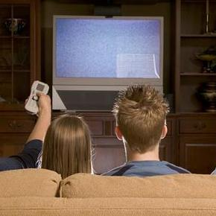
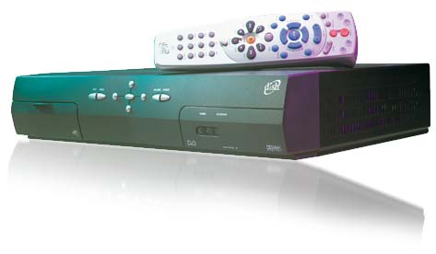
Key objectives of on-air promotion are two-fold
Build awareness for programming: maximize the # viewers who have heard of a program.
Drive tune-in to programming: maximize the # of viewers who watch or record a program.
Property Effective Media Services

Slide 3
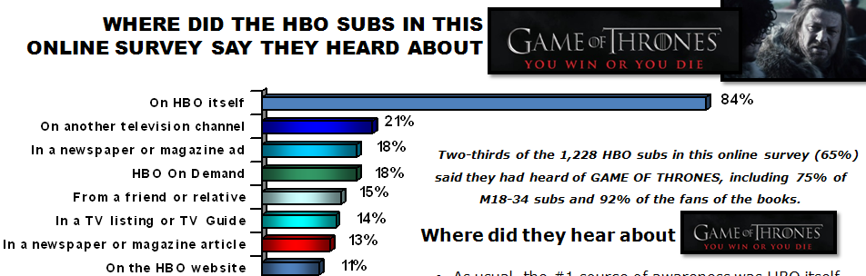
On-air promotion plays an essential role at a channel
For most networks, on-air promotion drives 75% of all tune-in.
Research on series premieres shows over 80% of typical viewers say they’ve seen something about the new series on the channel itself.
AUDIENCE RESEARCH EMS

Slide 4
On-air promotion is complicated and getting more complicated every day…
Scheduling on-air promotion 24 hours a day, 7 days a week, for multiple channels of any group
24 hours of promotion time on typical channel per month.
50+ promos in play on a weekly basis for an avg. of 10 different shows per week.
Rotate in 20-30 new spots per week.
On-Air Promotion considerations are many.
Must meet the target set for each on-air campaign and accommodate Legal, Senior Management, and Talent concerns.
Need to consider tone, genre, and sensitive subjects.
Build campaign toward premiere dates and provide continuity after the premiere (when off-channel marketing ends).
AUDIENCE RESEARCH EMS

Slide 5
Why An On-Air Schedule Planning Tool?
A planning tool will provide best practices in spot placement across all times of day across your channels, while substantially reducing the manual work required in putting together an on-air campaign.
A planning tool will allow On-Air Schedulers to set GRP goals, determine campaign/spot reach and frequency levels – compared with the less precise method of using daypart placement goals.
A planning tool will still enable On-Air Schedulers to override tool recommendations to take into account campaign sensitivities, and scheduler past experience, to achieve optimal spot placement.
A planning tool will help avoid over-delivery of placements, under-delivery of placements, and help identify an optimal plan for the creative elements in order to hit campaign targets.
AUDIENCE RESEARCH EMS

Slide 6



Reach, Frequency, and Tune-In Impact – Measures of promotion effectiveness
Reach = the total # of different viewers who have been exposed to a piece of promotion
Frequency = the average # of times viewers see a piece of promotion.
Tune-In Impact = The % of viewers who watched a program (telecast or on VOD), and also were exposed to the on-air promotion.
AUDIENCE RESEARCH EMS

Slide 7

New planning tool can help on-air promotion reach more viewers more frequently and more efficiently.
The GRiP it! system interfaces with traffic log system and network research data to optimize the scheduling of on-air assets.
Suggests an on-air promotion schedule that achieves the best reach and frequency results for on-air campaigns.
Works to maximize the viewing of each piece of creative developed for a campaign.
Develops scheduling plans to balance multiple program campaign demands on available break inventory.
AUDIENCE RESEARCH EMS

Slide 8
How does GRiP it! help?
GRiP it! will recommend a promotion flight to maximize the target audience for each campaign.
  The planning engine is based upon previous and current on-air campaigns.
  Uses actual Nielsen time period viewing data.
GRiP it! will help ensure each audience sees a campaign the right number of times.
  Optimally, viewers need at least 3-4 exposures for a campaign to be effective
  Estimates can be provided for the total campaign, by promotion element, and across linear channels.
GRiP it! will help the campaign to peak at the right time, as well as provide continuity planning benefits.
  Uses long range planning estimates (before the schedule exists), more precise estimates once the schedule is created, and final post-analysis of actual audience delivery.
AUDIENCE RESEARCH EMS

Slide 9
GRiP it! takes each piece of the on-air promotion process and adds them together to create the optimal campaign plan
Traffic/Scheduling System
Network Research
Campaign Goals
Promotion Elements
Promo Lengths
Versions
Final Review
Promo Time Available
Ratings
Cumes
Duplication Matrix
Review campaign before air
Make adjustments to accommodate all of channels needs
Creative Assets
GRP Goals
Target Demo Priority
AUDIENCE RESEARCH EMS

Slide 10

How does GRiP it! work?
+
The GRiP it! traffic system interfaces directly with channels traffic system to show…
  Available units
  Promo media library
  Program schedule
GRiP it! uses Nielsen research data
  Ratings: Assigned at a level of individual quarter-hour, half-hour, individual day & by demo using Nielsen ratings
  Cume/Reach: 1 and 4 week daypart reach figures are used, in conjunction with ratings, to model the reach/frequency profile of each schedule
  Matrix: Duplication Analysis
    Custom report profiling the duplication of viewers from one program to another to optimize spot placement around shows with similar audience appeal
Traffic/Scheduling System
Network Research
AUDIENCE RESEARCH EMS

Slide 11
How does GRiP it! work? (Continued)
Promotion Scheduling/OP/Marketing set campaign goals
  Strategic Audience Targets
  Reach and Frequency GRP Goals
GRiP it! works with the assets from Creative Services team
  Teasers
  Trailers
  Features, etc.
Campaign Goals
Creative Assets
  GRiP it! designs a campaign plan that will reach target goals; the Promotion Scheduling Team reviews the plan to make sure it meets channel needs and satisfies all of the key stakeholders.
Final Review
AUDIENCE RESEARCH EMS

Slide 12
Post-Campaign Effectiveness Analysis: GRiP it, in concert with Nielsen data, will provide tools and reports that will allow us to measure the effectiveness of each campaign – learnings that will enable us to create more effective and efficient campaigns.
Portfolio Campaign Overviews
  - What ran this week? Reach/Frequency results?
Campaign Details
  - Detailed Information & schedules for a campaign
Inventory Summary
- Material Specific Usage Details
Campaign Life Cycle
- Comprehensive Look at Campaign Performance Over Time
AUDIENCE RESEARCH EMS

